Slide 1
What is Stable Diffusion?
Stable Diffusion is a type of deep learning model used for generating images, typically based on text prompts. It works by iteratively refining random noise into a coherent image through a series of probabilistic diffusion steps.

Slide 2
Stable Diffusion Features
- High-quality image generation
- Supports text-to-image and image-to-image tasks
- Open-source and customizable
- Efficient use of computational resources
- Can run on consumer-grade GPUs

Slide 3
Types of Image Generation
- Text-to-Image: Generates images based on textual prompts.
- Image-to-Image: Enhances or transforms input images.
- Inpainting: Fills missing or corrupted areas in images.
- Outpainting: Extends an image beyond its original boundaries.

Slide 4
Stable Diffusion Comparison and Advantages
- Comparison:
- Outperforms GANs in diversity and quality.
- Faster and more efficient than other diffusion models.
- Advantages:
- Open-source, fostering community development.
- High-resolution image generation capabilities.
- Adaptable for various creative and industrial applications.

Slide 5
What is Latent Diffusion?
Latent Diffusion is a variant of diffusion models that operates in the latent space rather than directly on pixel space, enabling faster computation and higher-quality outputs by focusing on the most relevant features of the data.

Slide 6
Stable Diffusion Inference Flow
1. Text prompt is encoded into a latent representation.
2. Noise is progressively added to a latent vector.
3. A neural network refines the noise step-by-step.
4. Final output is decoded into an image through a decoder.

Slide 7
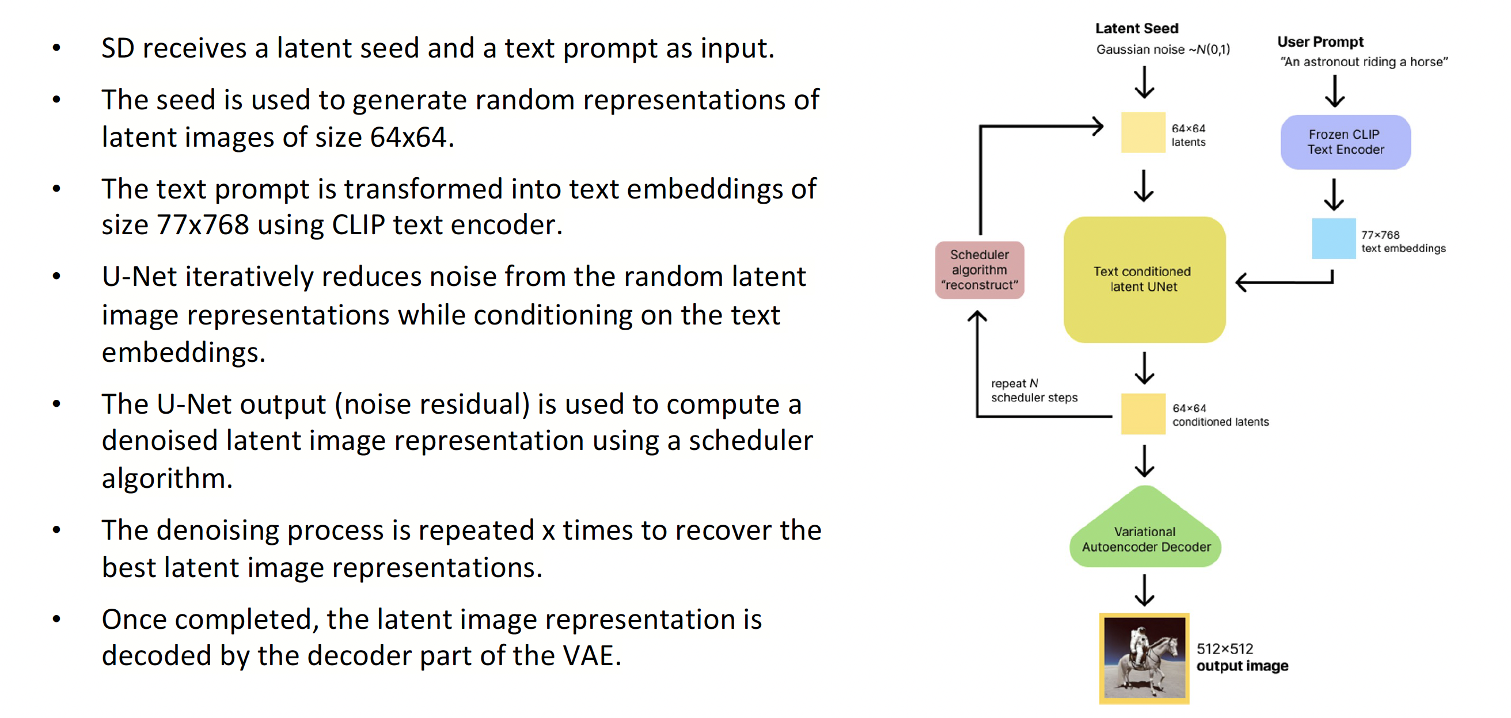
Stable Diffusion Inference

Slide 8
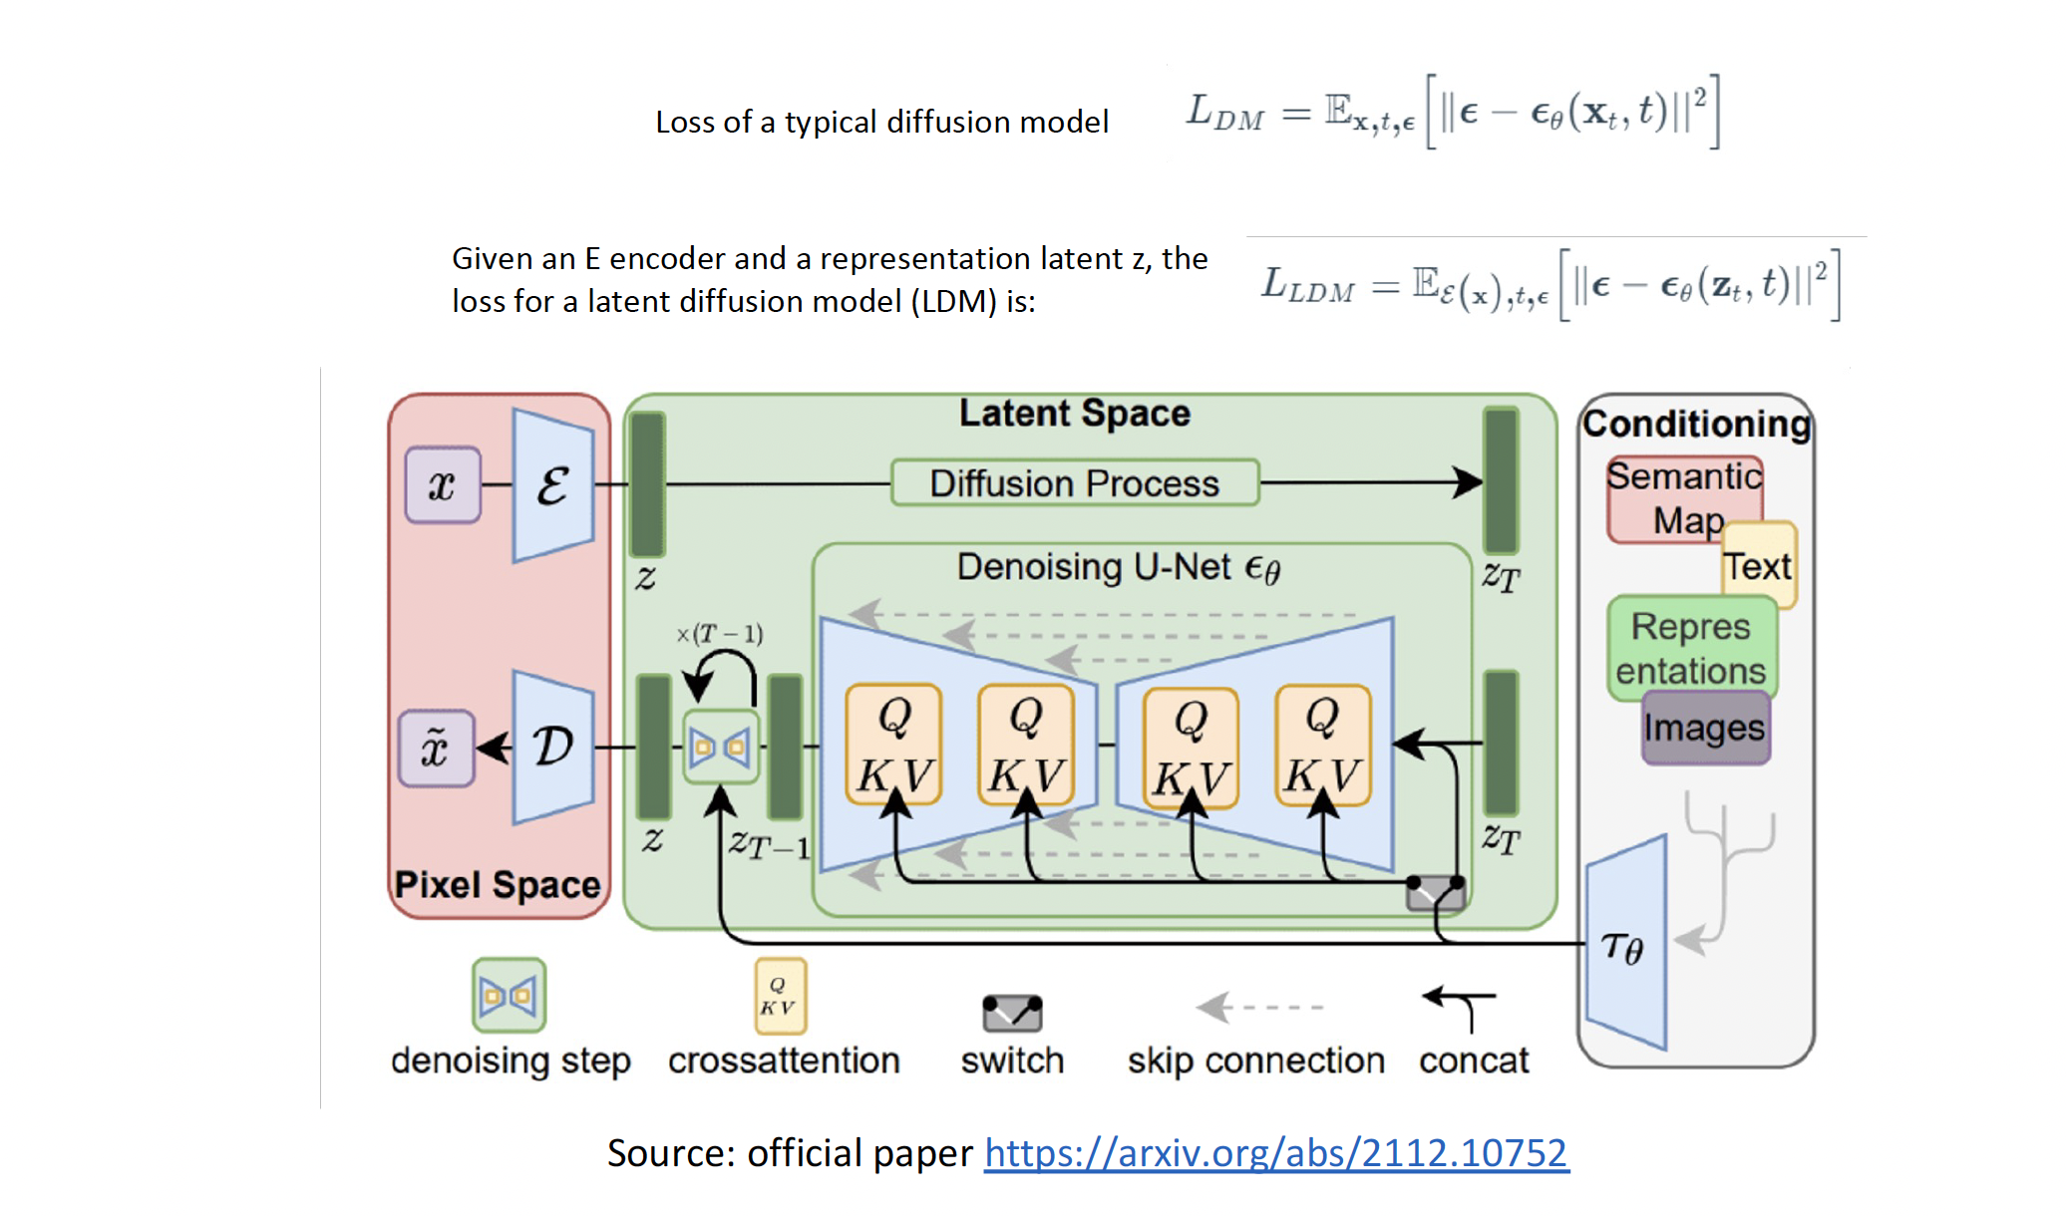
Latent Diffusion

Slide 9
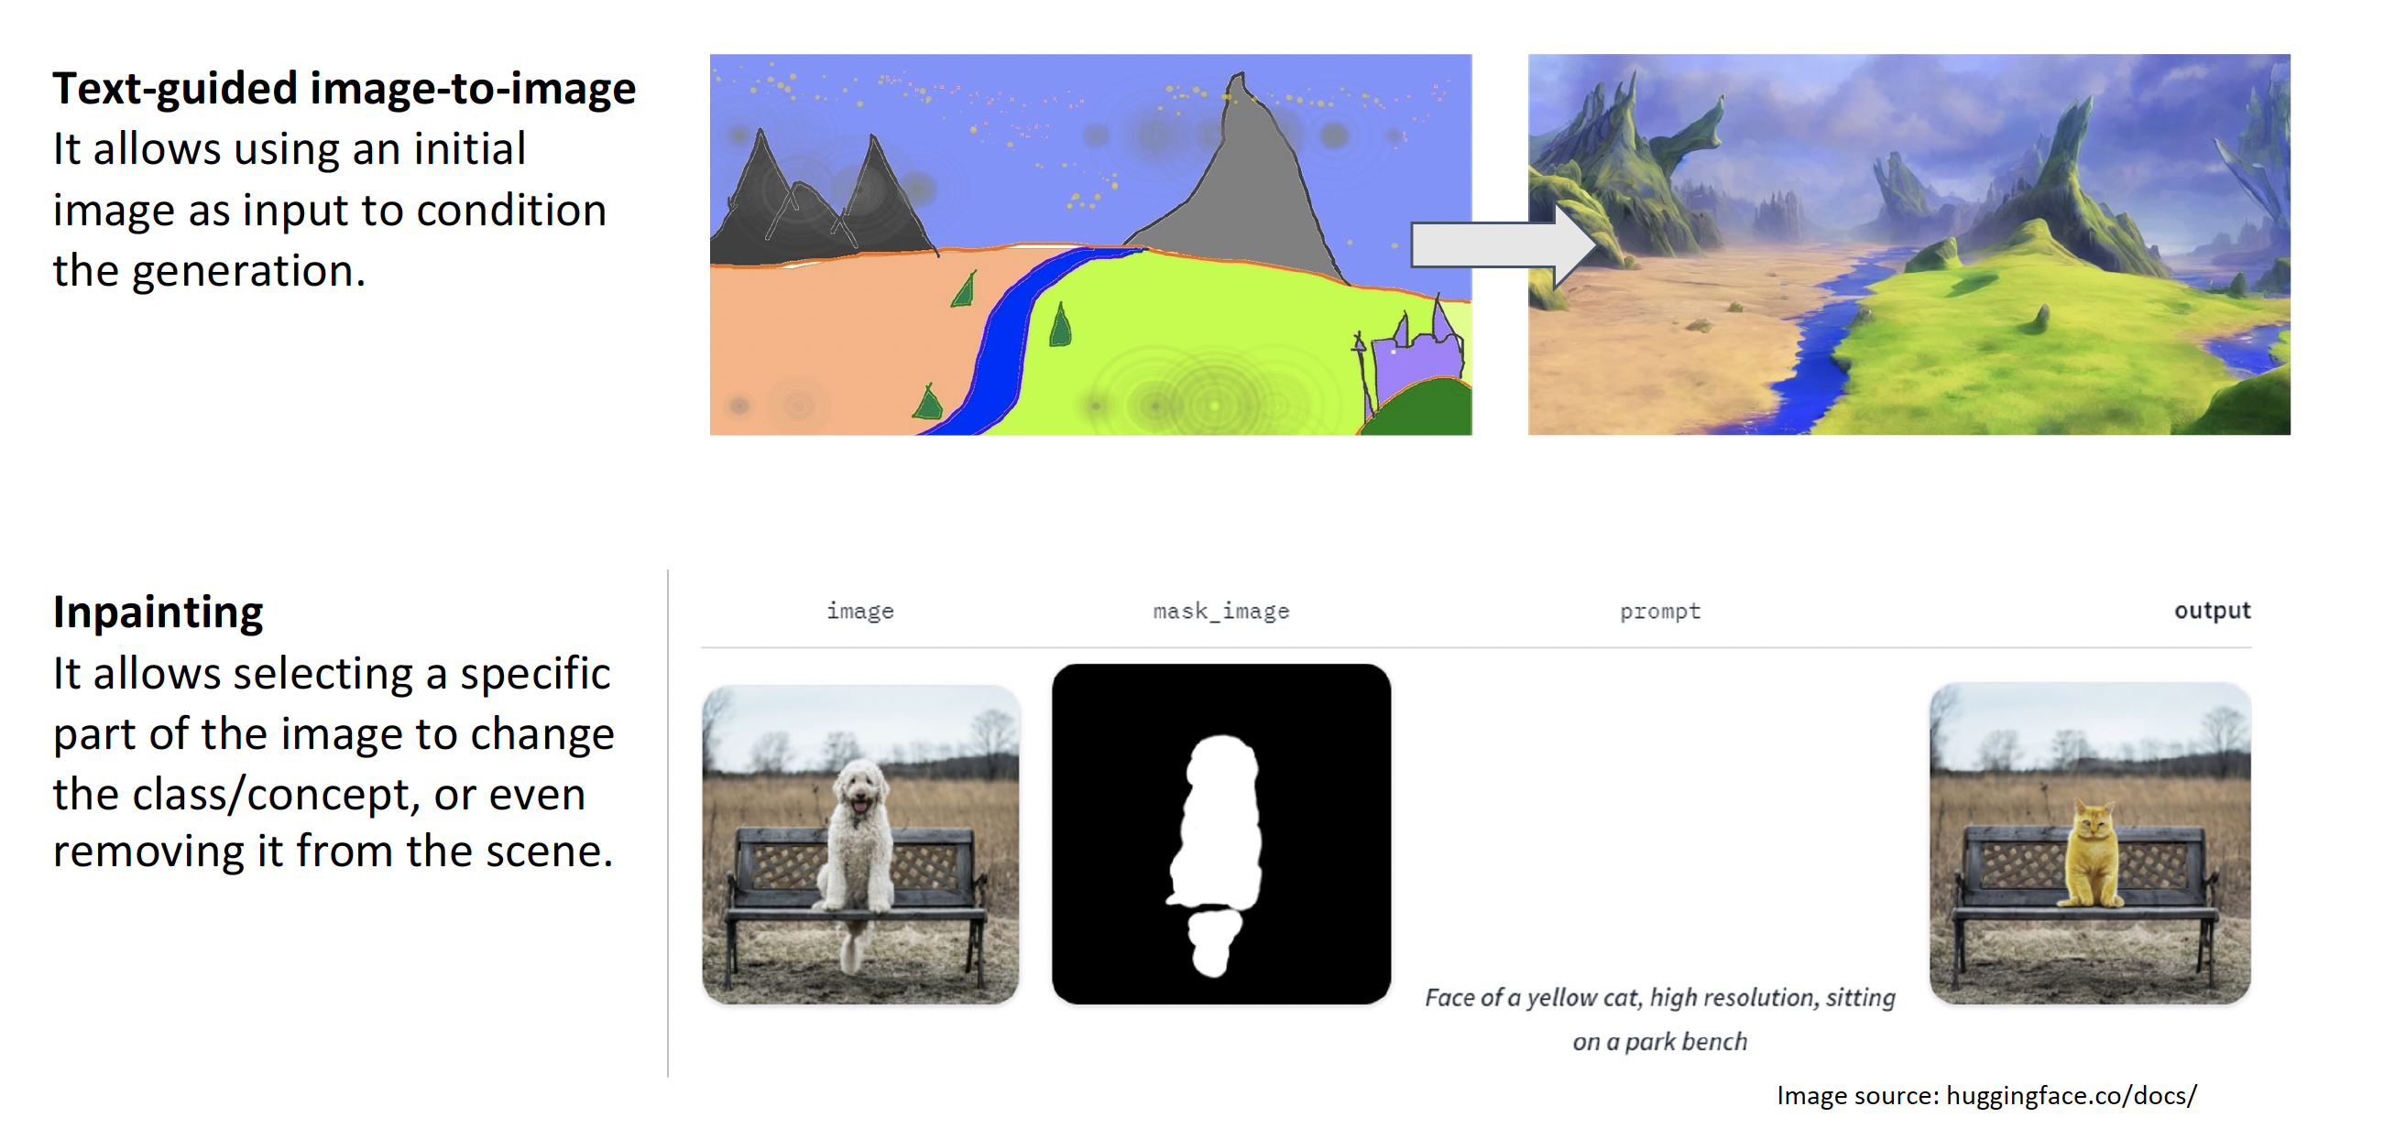
Features

Slide 10
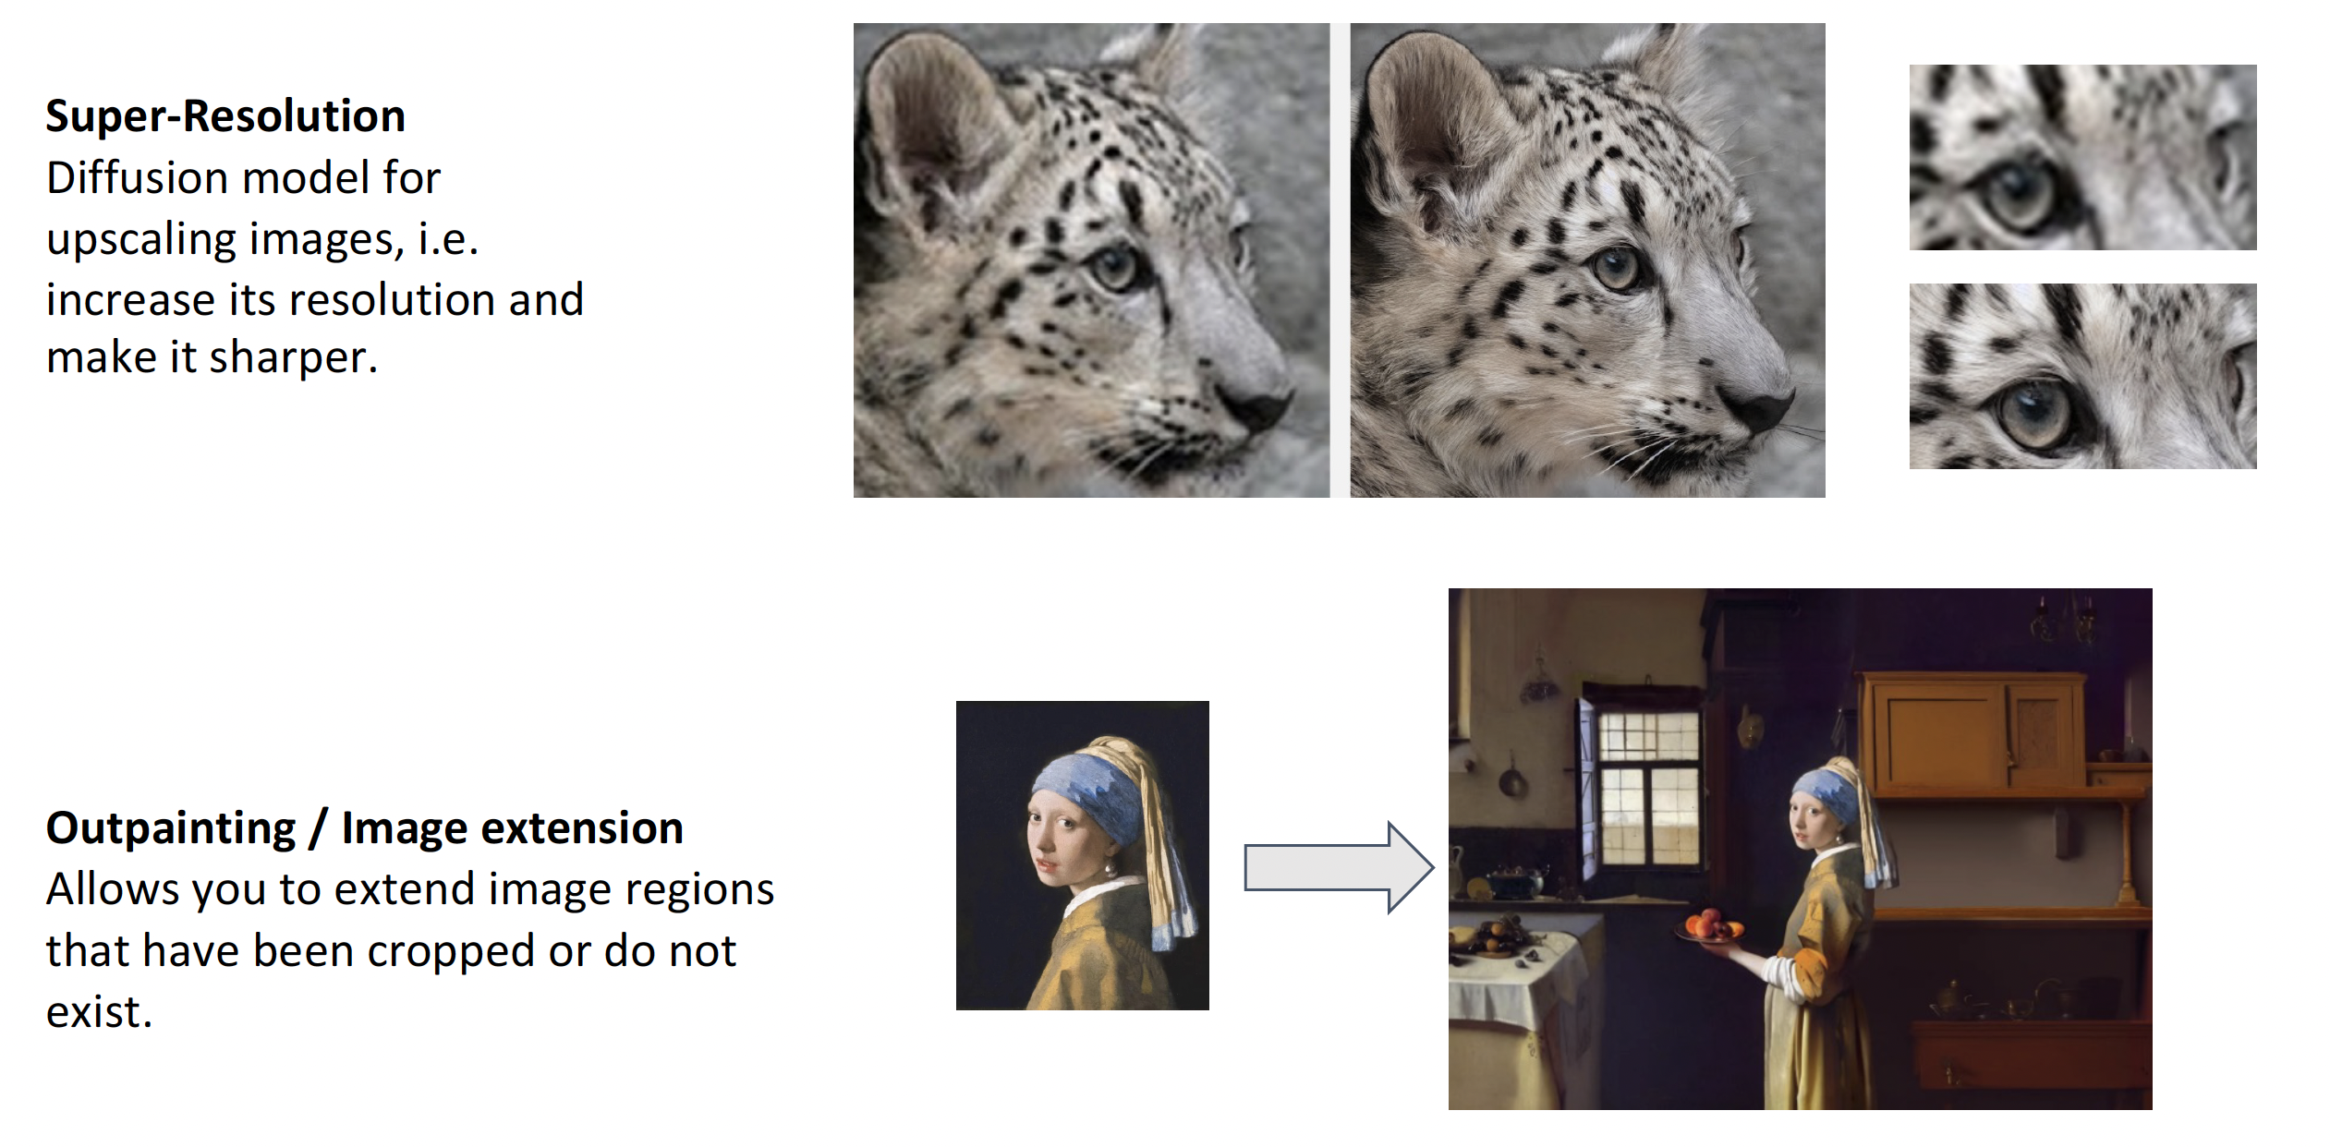
Features

Slide 11
Stable Diffusion
These models generates high quality images that did
not exist before.
Images can be produced from keyword correlations.
The model manages to correct the artistic style, faces
and shadows, and blends them together in an
aesthetically pleasing way.
This technique gained popularity due to its ability of
generationg good images using creative concepts and
unusual combination of keywords.

Slide 12
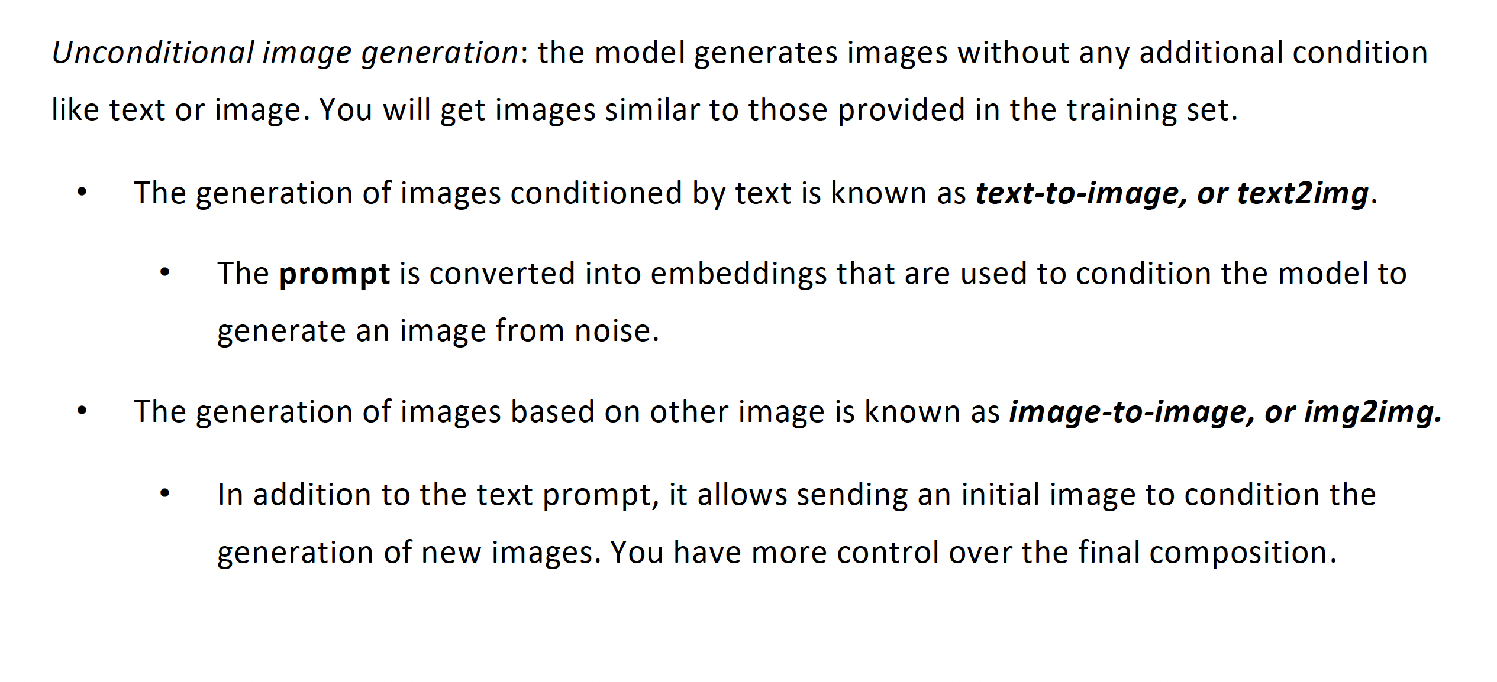
Types of Image Generation

Slide 13
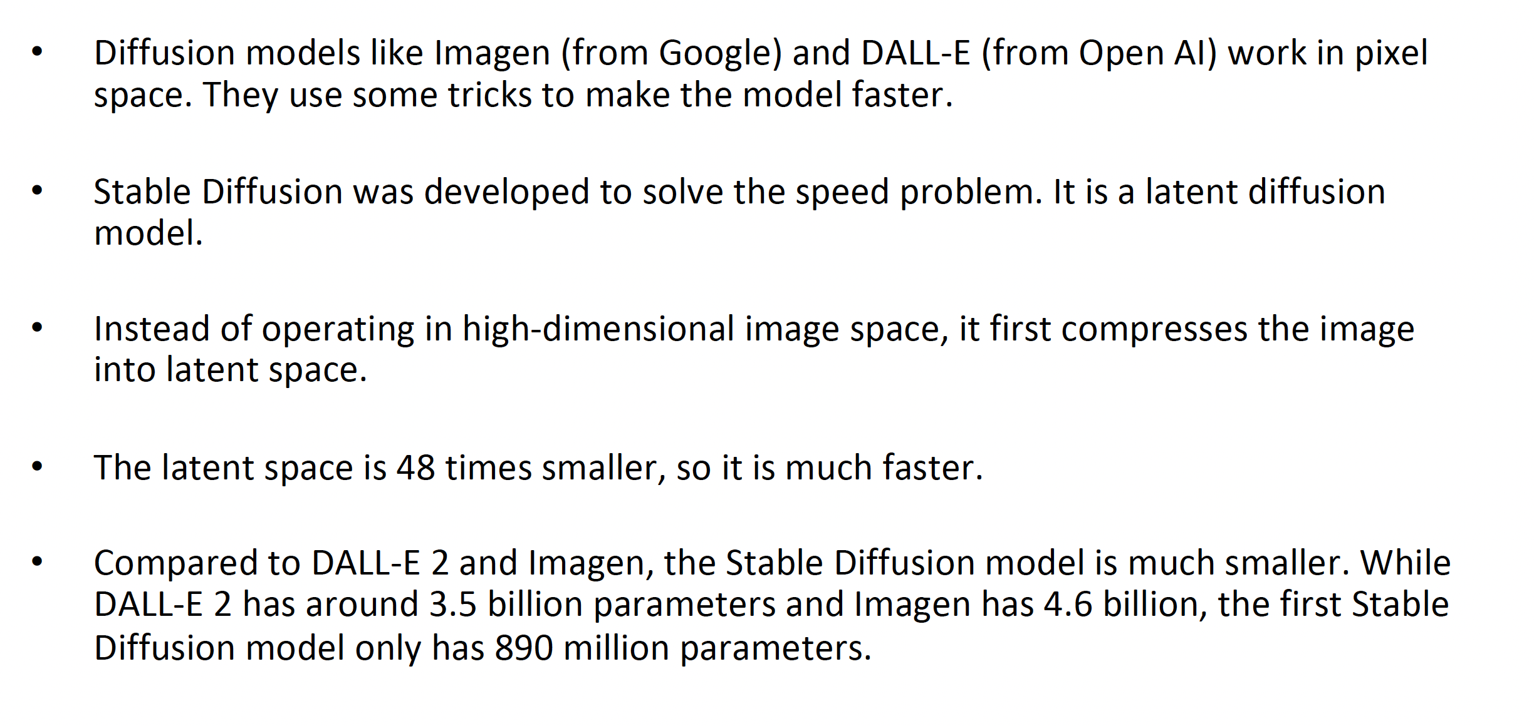
Comparison

